Slide 1
Optimizing Program Performance
60080013: Computer Organization
5th Lecture
Instructors:
Sun Heng

Slide 2
Performance Realities
Today, there are many occasions when making a program run fast is an important consideration. If a program must process video frames or network packets in real time, then a slow-running program will not provide the needed functionality. When a computation task is so demanding that it requires days or weeks to execute, then making it run just 20% faster can have significant impact. In this chapter, we will explore how to make programs run faster via several different types of program optimization.

Slide 3
Optimizing Activities
Writing an efficient program requires several types of activities:
Select an appropriate set of algorithms and data structures
Understand the capabilities and limitations of optimizing compilers
Divide a task into portions that can be computed in parallel

Slide 4
Capabilities of Optimizing Compilers
Seemingly minor changes in how a program is written can make large differences in how well a compiler can optimize it. Some programming languages are more easily optimized than others. Some features of C, such as the ability to perform pointer arithmetic and casting, make it challenging for a compiler to optimize. Programmers can often write their programs in ways that make it easier for compilers to generate efficient code.

Slide 5
Limitations of Optimizing Compilers
Compilers must be careful to apply only safe optimizations to a program, meaning that the resulting program will have the exact same behavior as would an unoptimized version for all possible cases the program may encounter, up to the limits of the guarantees provided by the C language standards. Constraining the compiler to perform only safe optimizations eliminates possible sources of undesired run-time behavior, but it also means that the programmer must make more of an effort to write programs in a way that the compiler can then transform into efficient machine-level code.

Slide 6
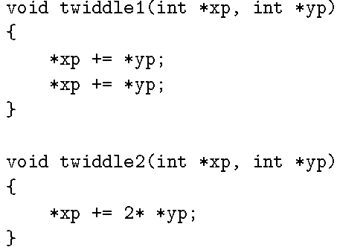
Limitations of Optimizing Compilers
To appreciate the challenges of deciding which program transformations are safe or not, consider the following two procedures:

Slide 7

Limitations of Optimizing Compilers
Consider, however, the case in which xp and yp are equal. Then function twiddle1 will perform the following computations:
The result will be that the value at xp will be increased by a factor of 4. On the other hand, function twiddle2 will perform the following computation:
The result will be that the value at xp will be increased by a factor of 3.

Slide 8
Optimization Blocker: Memory Aliasing
Aliasing
  Two different memory references specify single location
  Easy to have happen in C
    Since allowed to do address arithmetic
    Direct access to storage structures
  Get in habit of introducing local variables
    Accumulating within loops
    Your way of telling compiler not to check for aliasing

Slide 9
Expressing Program Performance
We introduce the metric cycles per element, abbreviated “CPE,” as a way to express program performance in a way that can guide us in improving the code.
CPE measurements help us understand the loop performance of an iterative program at a detailed level.

Slide 10
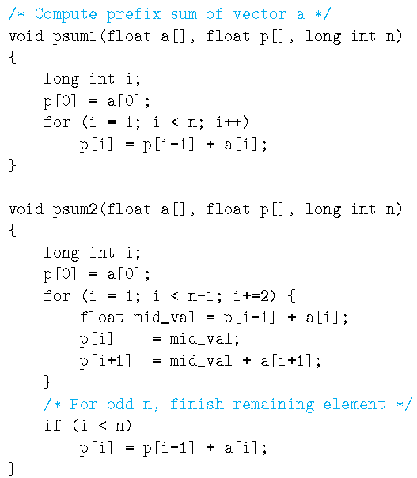


CPE
Many procedures contain a loop that iterates over a set of elements. For example, functions psum1 and psum2:
Functions psum1 and psum2 both compute the prefix sum of a vector of length n.
For a vector:
the prefix sum:
is defined as:

Slide 11
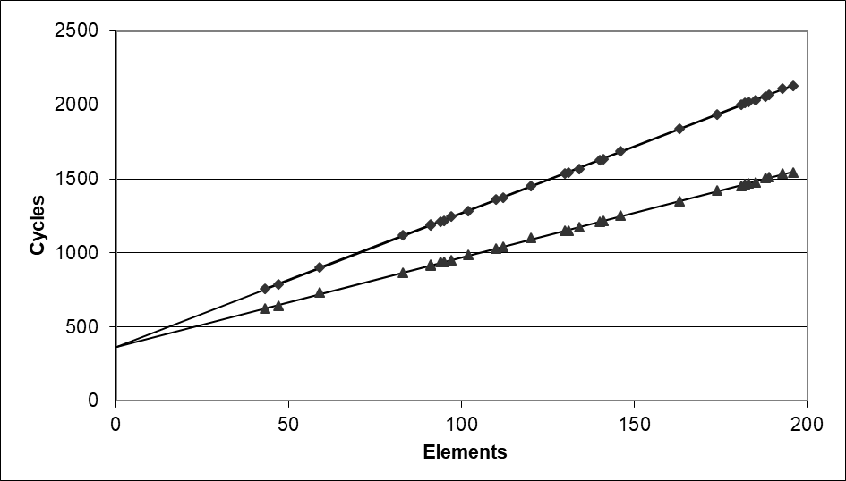
CPE
The time required by the two procedures can be characterized as a constant plus a factor proportional to the number of elements processed.
Using a least squares fit, we find that the run times (in clock cycles) for psum1 and psum2 can be approximated by the equations 368 + 9.0n and 368 + 6.0n, respectively.
We refer to the coefficients in these terms as the effective number of cycles per element, abbreviated “CPE.” We prefer measuring the number of cycles per element rather than the number of cycles per iteration. By this measure, psum2, with a CPE of 6.0, is superior to psum1, with a CPE of 9.0.
psum1
Slope = 9.0
psum2
Slope = 6.0

Slide 12
Benchmark Example: Data Type for Vectors
/* data structure for vectors */
typedef struct{
int len;
data_t *data;
} vec;
len
0
1
len-1
data
/* retrieve vector element and store at val */
double get_vec_element(*vec, idx, data_t *val)
{
if (idx < 0 || idx >= vec->len)
return 0;
*val = vec->data[idx];
return 1;
}

Slide 13
Benchmark Computation
void combine1(vec_ptr v, data_t *dest)
{
long int i;
*dest = IDENT;
for (i = 0; i < vec_length(v); i++) {
data_t val;
get_vec_element(v, i, &val);
*dest = *dest OP val;
}
}
Compute sum or product of vector elements
Data Types
  Use different declarations for data_t
  int
  long
  float
  double
Operations
  Use different definitions of OP and IDENT
  + / 0
  * / 1

Slide 14
Benchmark Performance
To gauge progress, we measured the CPE performance of the functions on a machine with an Intel Core i7 Haswell processor, which we refer to as our reference machine.
As a starting point, the following are CPE measurements for data type and combining operation. For single-precision and double-precision floating-point data, our experiments on this machine gave identical performance for addition and multiplication. We therefore report four CPE values: integer addition and multiplication, floating-point addition and multiplication.
Method | Integer |  | Double FP
Operation | Add | Mult | Add | Mult
Combine1 unoptimized | 22.68 | 20.02 | 19.98 | 20.18
Combine1 –O1 | 10.12 | 10.12 | 10.17 | 11.14
Results in CPE (cycles per element)

Slide 15
Eliminating Loop Inefficiencies
Original combine1:
void combine1(vec_ptr v, data_t *dest)
{
long int i;
*dest = IDENT;
for (i = 0; i < vec_length(v); i++) {
data_t val;
get_vec_element(v, i, &val);
*dest = *dest OP val;
}
}

Slide 16
Eliminating Loop Inefficiencies
void combine2(vec_ptr v, data_t *dest)
{
long int i;
long int length = vec_length(v);
*dest = IDENT;
for (i = 0; i < length; i++) {
data_t val;
get_vec_element(v, i, &val);
*dest = *dest OP val;
}
}
Code motion involves identifying a computation that is performed multiple times (e.g., within a loop), but such that the result of the computation will not change. We can therefore move the computation to an earlier section of the code that does not get evaluated as often.

Slide 17
Eliminating Loop Inefficiencies
void combine2(vec_ptr v, data_t *dest)
{
long int i;
long int length = vec_length(v);
*dest = IDENT;
for (i = 0; i < length; i++) {
data_t val;
get_vec_element(v, i, &val);
*dest = *dest OP val;
}
}
Method | Integer |  | Double FP
Operation | Add | Mult | Add | Mult
Combine1 | 10.12 | 10.12 | 10.17 | 11.14
Combine2 | 7.02 | 9.03 | 9.02 | 11.03
Results in CPE (cycles per element)

Slide 18
Reducing Procedure Calls
void combine2(vec_ptr v, data_t *dest)
{
long int i;
long int length = vec_length(v);
*dest = IDENT;
for (i = 0; i < length; i++) {
data_t val;
get_vec_element(v, i, &val);
*dest = *dest OP val;
}
}
Procedure calls can incur overhead and also block most forms of program optimization. We can see in the code for combine2 that get_vec_element is called on every loop iteration to retrieve the next vector element. This function checks the vector index i against the loop bounds with every vector reference, a clear source of inefficiency. Bounds checking might be a useful feature when dealing with arbitrary array accesses, but a simple analysis of the code for combine2 shows that all references will be valid.

Slide 19
Reducing Procedure Calls
void combine3(vec_ptr v, data_t *dest)
{
long int i;
long int length = vec_length(v);
data_t *data = get_vec_start(v);
*dest = IDENT;
for (i = 0; i < length; i++) {
*dest = *dest OP data[i];
}
}
Suppose instead that we add a function get_vec_start to our abstract data type. This function returns the starting address of the data array. We could then write the procedure shown as combine3 in this code, having no function calls in the inner loop. Rather than making a function call to retrieve each vector element, it accesses the array directly.

Slide 20
Reducing Procedure Calls
void combine3(vec_ptr v, data_t *dest)
{
long int i;
long int length = vec_length(v);
data_t *data = get_vec_start(v);
*dest = IDENT;
for (i = 0; i < length; i++) {
*dest = *dest OP data[i];
}
}
Results in CPE (cycles per element)
Method | Integer |  | Double FP
Operation | Add | Mult | Add | Mult
Combine2 | 7.02 | 9.03 | 9.02 | 11.03
Combine3 | 7.17 | 9.02 | 9.02 | 11.03
Surprisingly, there is no apparent performance improvement. Indeed, the performance for integer sum has gotten slightly worse.

Slide 21
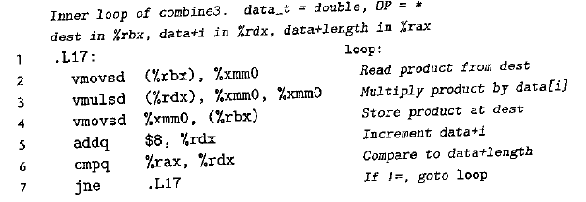
Eliminating Unneeded Memory References
The code for combine3 accumulates the value being computed by the combining operation at the location designated by the pointer dest. This attribute can be seen by examining the assembly code generated for the compiled loop. We show here the x86-64 code generated for data type float and with multiplication as the combining operation:
We see in this loop code that the address corresponding to pointer dest is held in register %rbx. On iteration i, the program reads the value at this location, multiplies it by data[i], and stores the result back at dest. This reading and writing is wasteful, since the value read from dest at the beginning of each iteration should simply be the value written at the end of the previous iteration.

Slide 22
Eliminating Unneeded Memory References
void combine4(vec_ptr v, data_t *dest)
{
int i;
int length = vec_length(v);
data_t *d = get_vec_start(v);
data_t acc = IDENT;
for (i = 0; i < length; i++)
acc = acc OP d[i];
*dest = acc;
}
We can eliminate this needless reading and writing of memory by rewriting the code in the style of combine4 in this code. We introduce a temporary variable acc that is used in the loop to accumulate the computed value. The result is stored at dest only after the loop has been completed.
Compared to the loop in combine3, we have reduced the memory operations per iteration from two reads and one write to just a single read.

Slide 23
Eliminating Unneeded Memory References
void combine4(vec_ptr v, data_t *dest)
{
int i;
int length = vec_length(v);
data_t *d = get_vec_start(v);
data_t acc = IDENT;
for (i = 0; i < length; i++)
acc = acc OP d[i];
*dest = acc;
}
Method | Integer |  | Double FP
Operation | Add | Mult | Add | Mult
Combine3 | 7.17 | 9.02 | 9.02 | 11.03
Combine4 | 1.27 | 3.01 | 3.01 | 5.01
With this final transformation, we reached a point where we require just 1.2–5 clock cycles for each element to be computed. This is a considerable improvement over the original 10–11 cycles when we first enabled optimization.

Slide 24

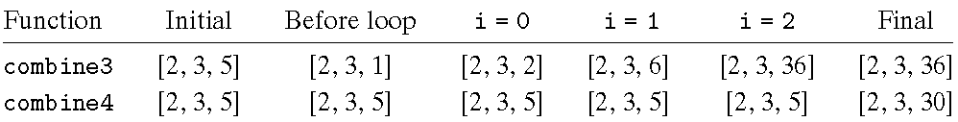
Combine3 vs. Combine4
Consider, the case of integer data with multiplication as the operation and 1 as the identity element. Let v = [2, 3, 5] be a vector of three elements and consider the following two function calls:
That is, we create an alias between the last element of the vector and the destination for storing the result. The two functions would then execute as follows:
combine3 accumulates its result at the destination, which in this case is the final vector element. This value is therefore set first to 1, then to 2× 1= 2, and then to 3×2 = 6. On the final iteration, this value is then multiplied by itself to yield a final value of 36. For the case of combine4, the vector remains unchanged until the end, when the final element is set to the computed result 1×2×3×5 = 30.

Slide 25
Classwork
Problem 5.3.

Slide 26
Modern CPU Design
Instruction Control
Fetch
Control
Address
Instruction
Cache
Retirement
Unit
Register
File
Instruction
Decode
Instructions
Operations
Register Updates
Prediction OK?
Execution
Functional
Units
Branch
Arith
Arith
Arith
Load
Store
Operation Results
Addr.
Addr.
Data
Data
Data
Cache

Slide 27
Superscalar Processor
Definition: A superscalar processor can issue and execute multiple instructions in one cycle. The instructions are retrieved from a sequential instruction stream and are usually scheduled dynamically.
Benefit: without programming effort, superscalar processor can take advantage of the instruction level parallelism that most programs have
Most modern CPUs are superscalar.
Intel: since Pentium (1993)

Slide 28
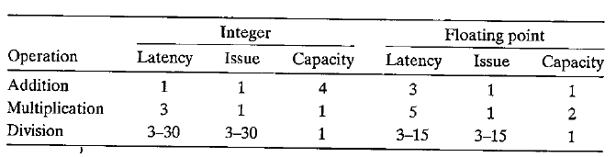
Functional Unit Performance
Latency: the total time required to perform the operation
Issue time: the minimum number of clock cycles between two successive operations of the same type
Capacity: the number of functional units capable of performing that operation
Throughput: the reciprocal of the issue time

Slide 29
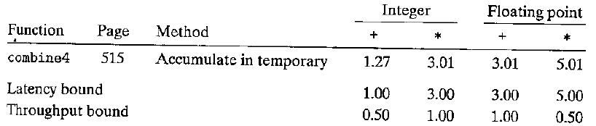
Two Fundamental Bounds on the CPE Values
Latency bound: a minimum value for the CPE for any function that must perform the combining operation in a strict sequence.
Throughput bound: a minimum bound for the CPE based on the maximum rate at which the functional units can produce results.

Slide 30
Abstract Model of Processor Operation
Data-flow representation: a graphical notation showing how the data dependencies between the different operations constrain the order in which they are executed.
Critical paths: a lower bound on the number of clock cycles required to execute a set of machine instructions.

Slide 31
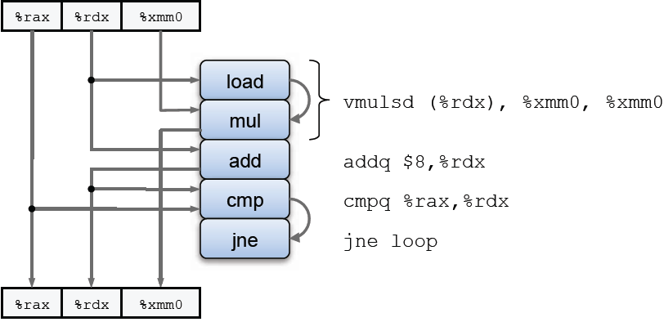
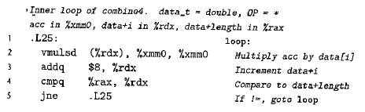
From Machine-Level Code to Data-Flow Graphs
void combine4(vec_ptr v, data_t *dest)
{
int i;
int length = vec_length(v);
data_t *d = get_vec_start(v);
data_t acc = IDENT;
for (i = 0; i < length; i++)
acc = acc OP d[i];
*dest = acc;
}

Slide 32
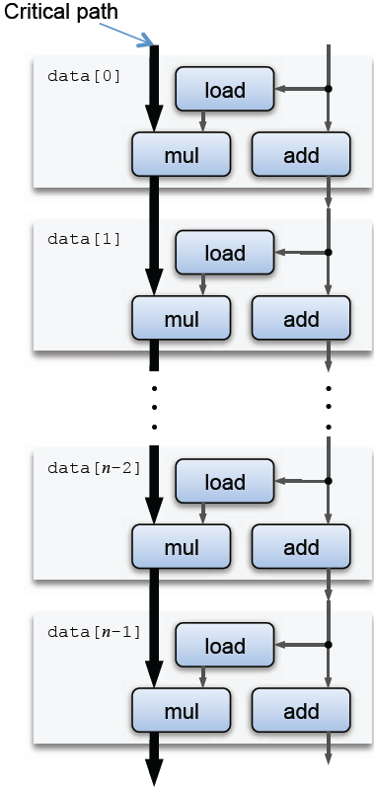
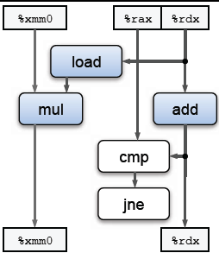
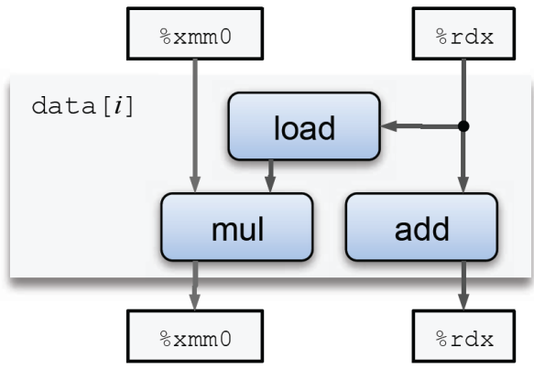
From Machine-Level Code to Data-Flow Graphs

Slide 33
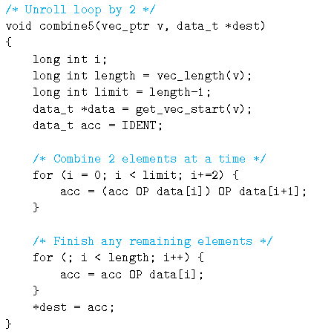
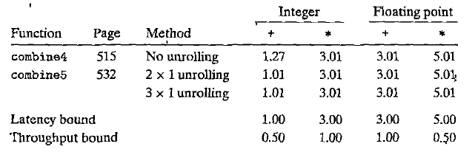
Loop Unrolling

Slide 34
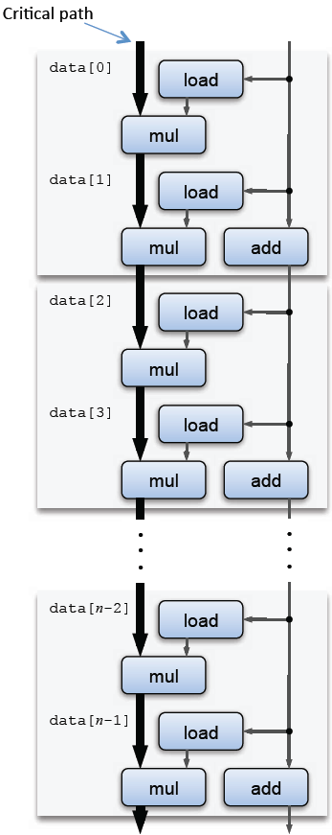
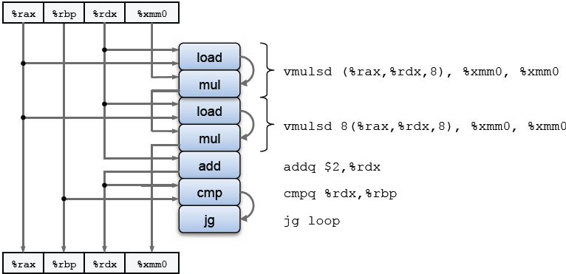
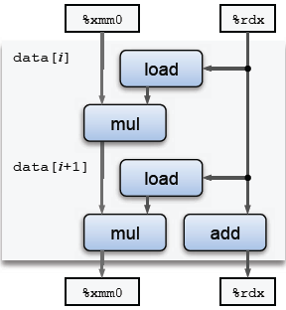
Loop Unrolling

Slide 35
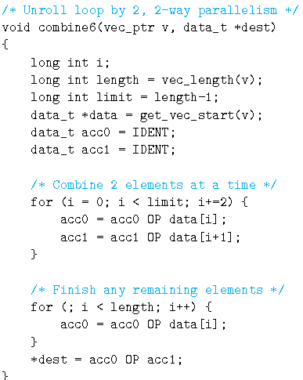
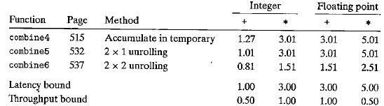
Enhancing Parallelism

Slide 36
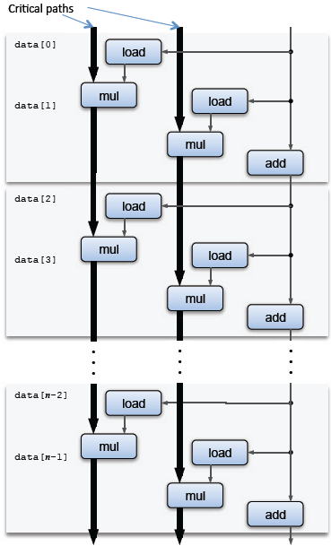
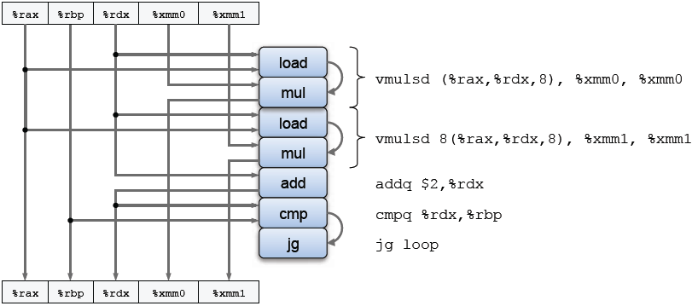
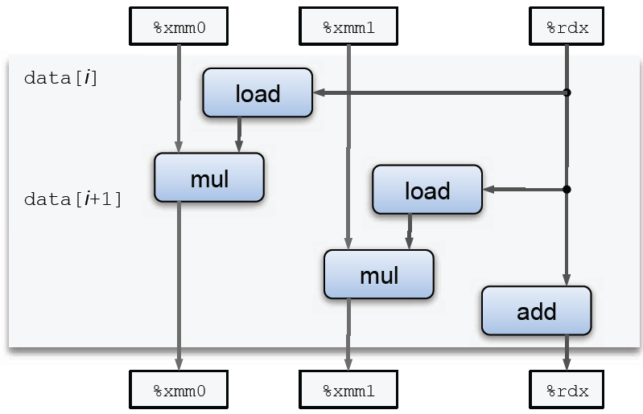
Enhancing Parallelism

Slide 37
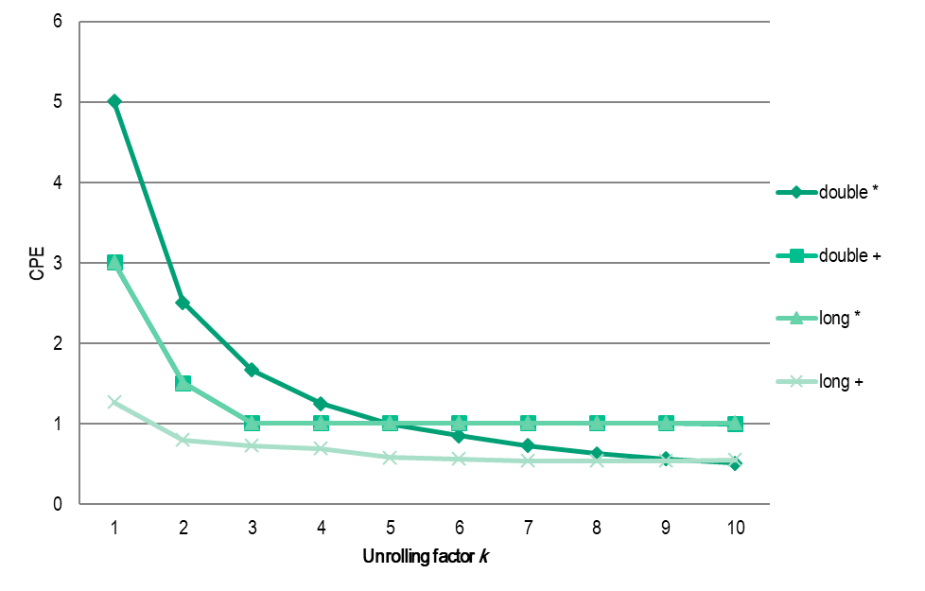
Enhancing Parallelism
K X K unrolling
 | 1 | 2 | 3 | 4 | 5 | 6 | 7 | 8 | 9 | 10
double * | 5.01 | 2.51 | 1.67 | 1.25 | 1 | 0.85 | 0.73 | 0.63 | 0.56 | 0.51
double + | 3.01 | 1.51 | 1.01 | 1.01 | 1.01 | 1.01 | 1.01 | 1.01 | 1.01 | 1
long * | 3.01 | 1.51 | 1.01 | 1.01 | 1.01 | 1.01 | 1.01 | 1.01 | 1.01 | 1.01
long + | 1.27 | 0.8 | 0.73 | 0.69 | 0.58 | 0.56 | 0.54 | 0.54 | 0.54 | 0.55

Slide 38
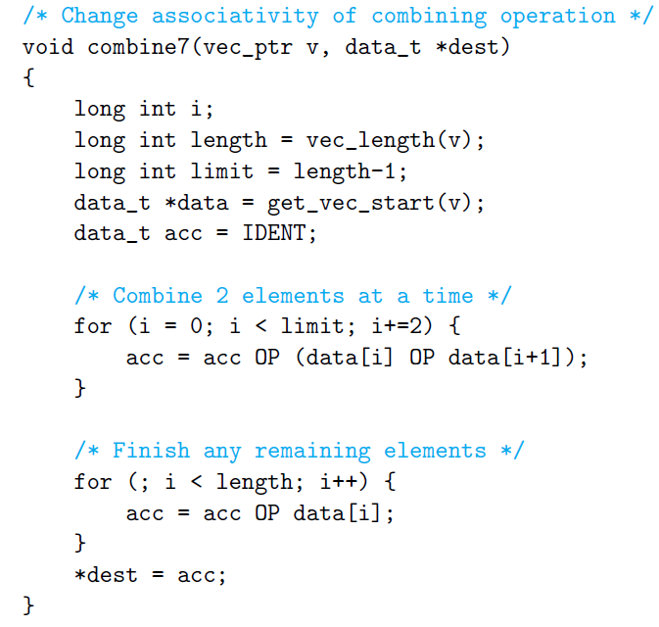
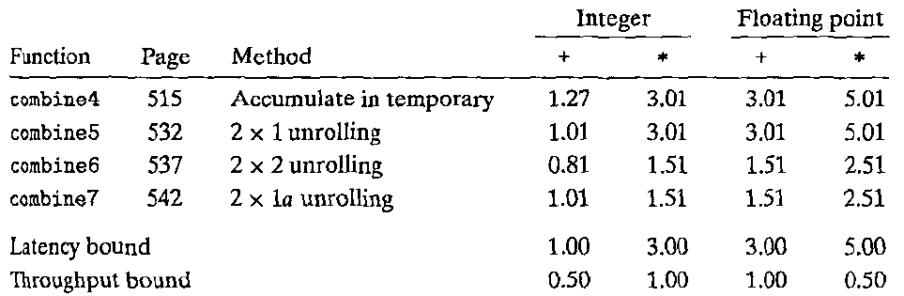
Reassociation Transformation

Slide 39
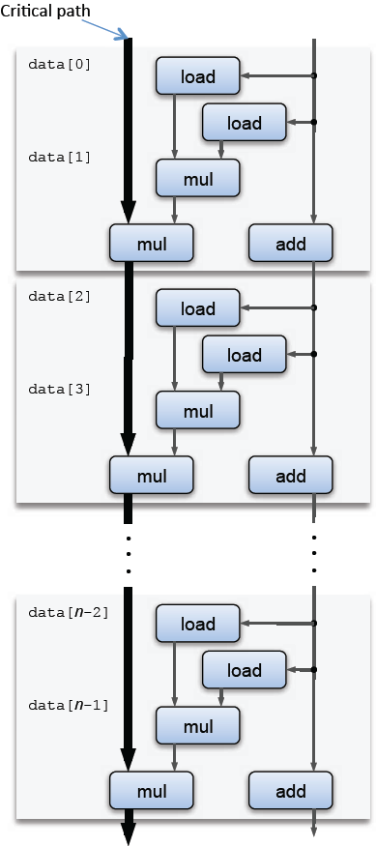
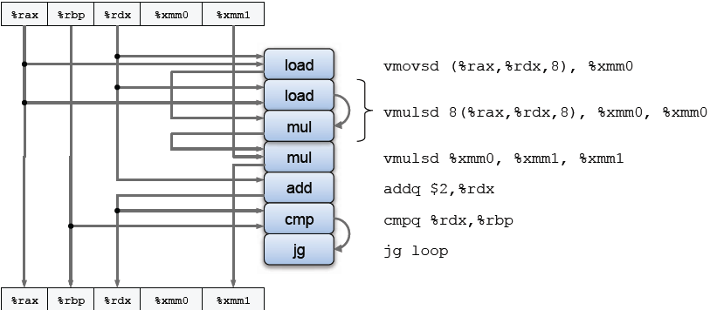
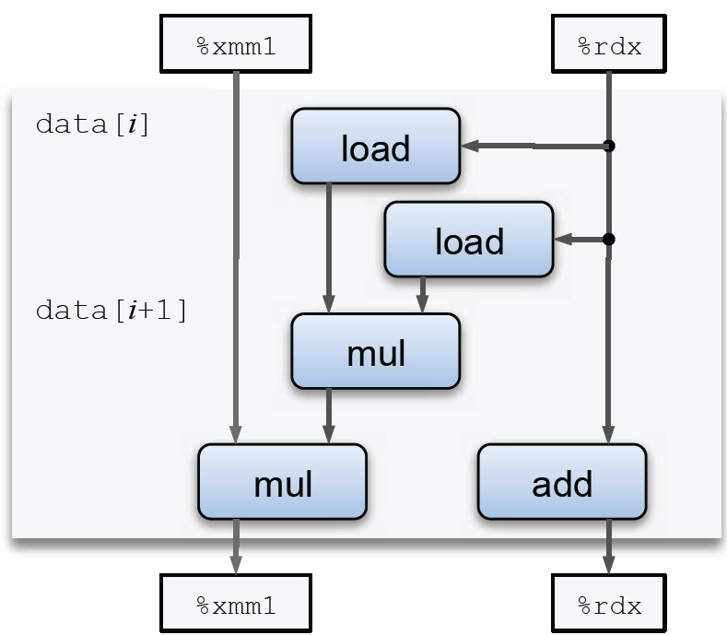
Reassociation Transformation

Slide 40
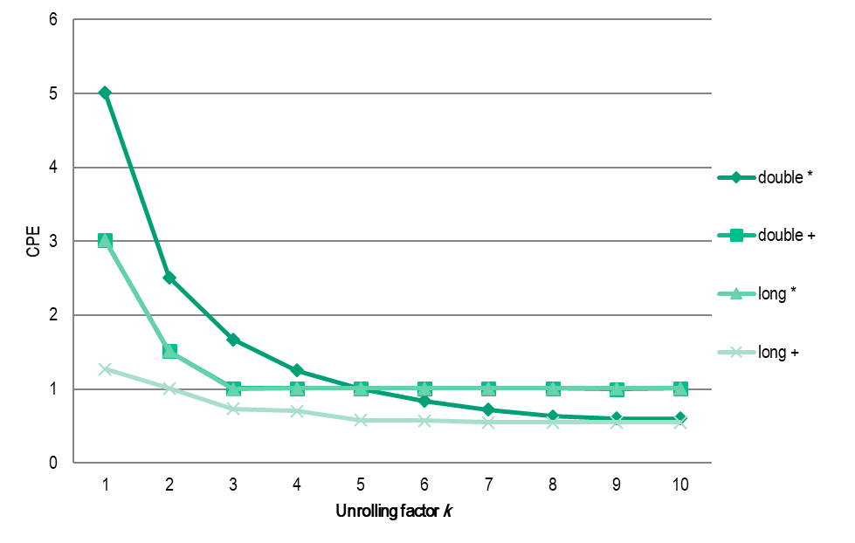
Reassociation Transformation
K x unrolling, reassociate
 | 1 | 2 | 3 | 4 | 5 | 6 | 7 | 8 | 9 | 10
double * | 5.01 | 2.51 | 1.67 | 1.25 | 1 | 0.84 | 0.72 | 0.63 | 0.6 | 0.6
double + | 3.01 | 1.51 | 1.01 | 1.01 | 1.01 | 1.01 | 1.01 | 1.01 | 1 | 1.01
long * | 3.01 | 1.51 | 1 | 1.01 | 1.01 | 1.01 | 1.01 | 1.01 | 1.01 | 1.01
long + | 1.27 | 1.01 | 0.73 | 0.7 | 0.58 | 0.57 | 0.55 | 0.55 | 0.55 | 0.55

Slide 41
Classwork
Problem 5.8, 5.15.

